Slide 1
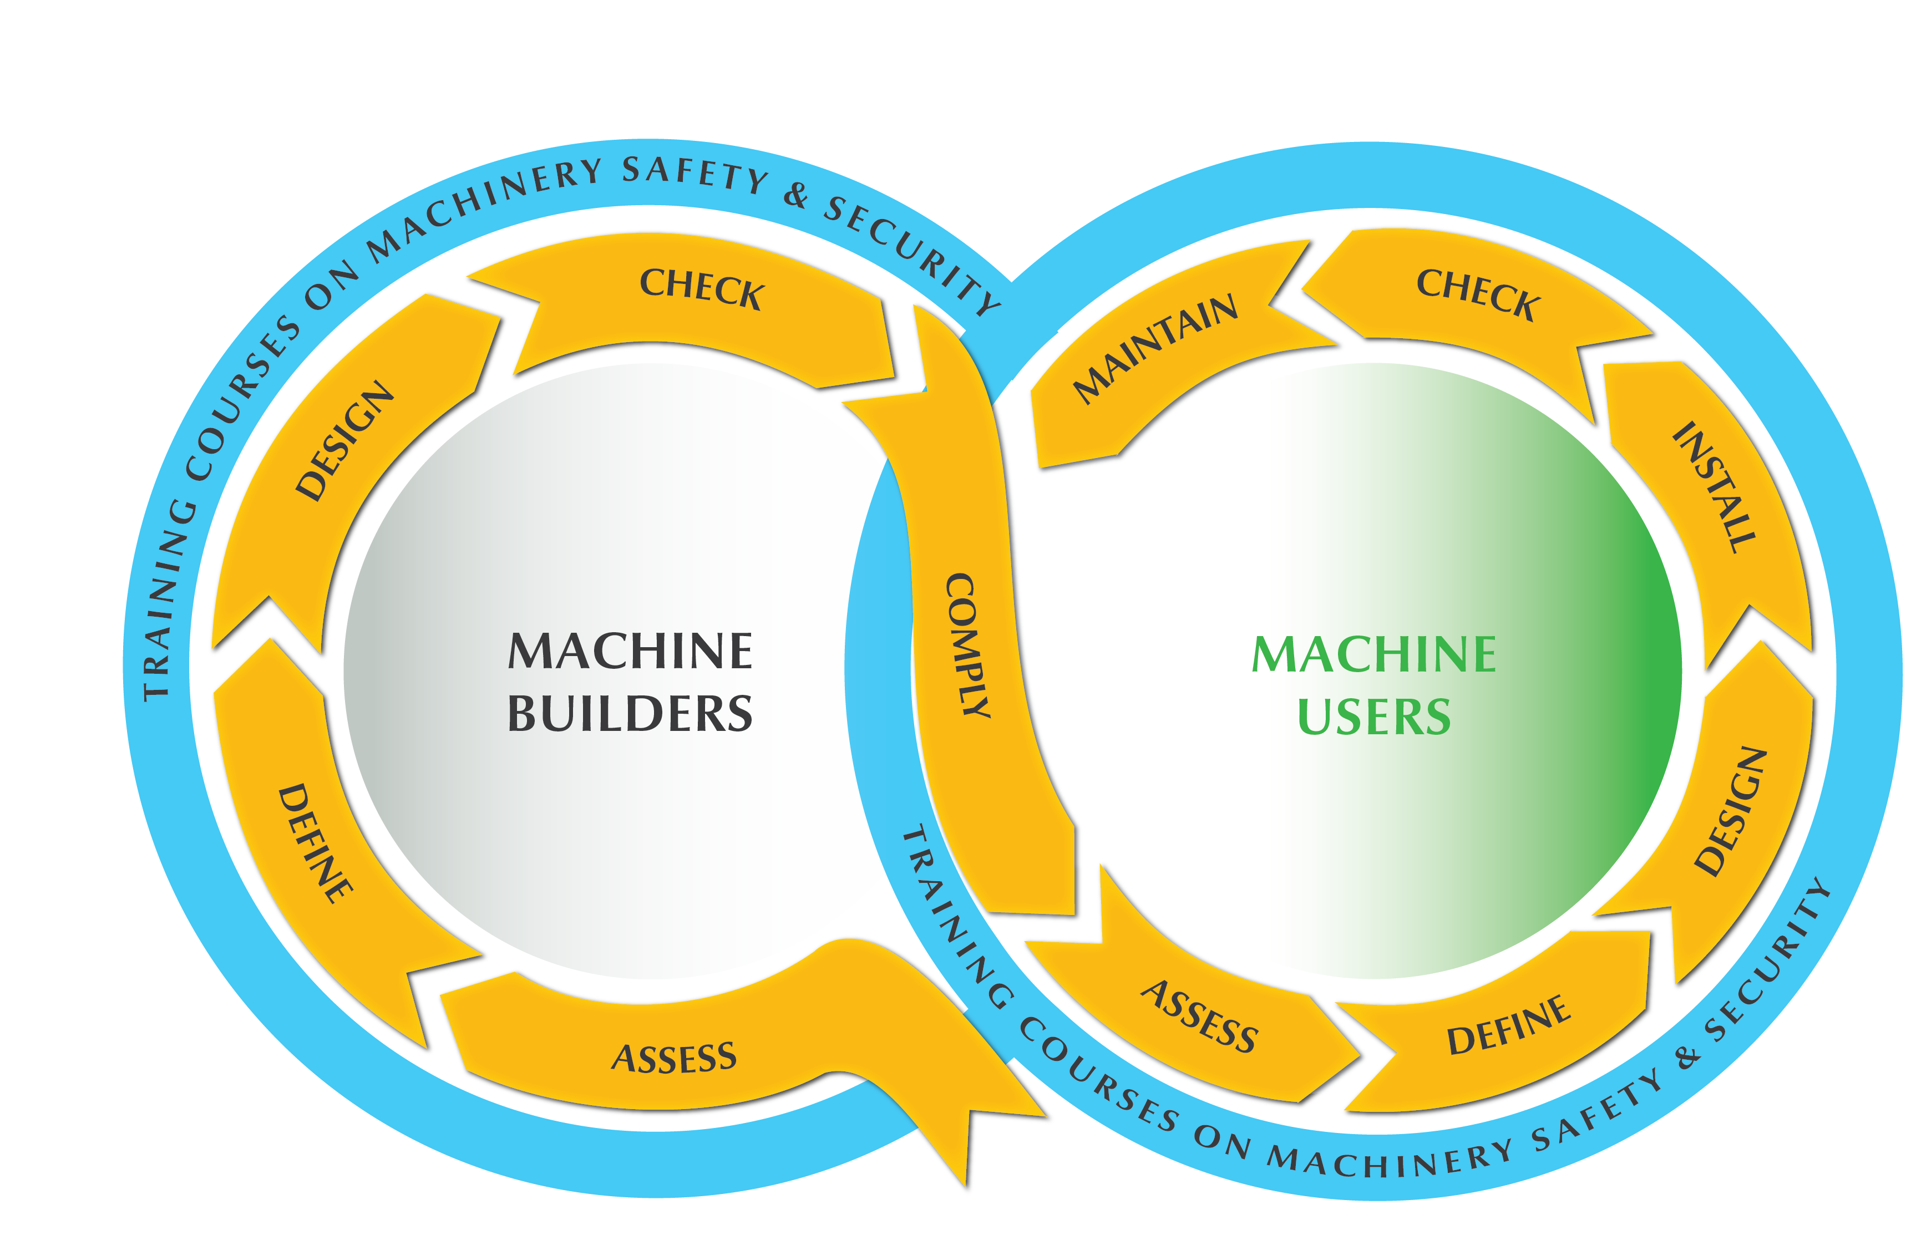
Safety Throughout your Machine’s Operational Lifecycle
Our Services

Slide 2
Safety Throughout your Machine’s Operational Lifecycle
Machine Safety Lifecycle for Machine Builders
ASSESS | Design Risk Assessment (DRA) Machine Risk Assessment (RA) Security Risk Assessment (SRA)
DEFINE | Safety Concept (SC) Safety Requirements Specification (SRS)
DESIGN | Safe Design (SD)
CHECK | Post-Measures Risk Assessment (PMRA) Safety Validation / Safety Verification (SV)
COMPLY | Compliance with Local and International Legislations & Regulations (e.g. CE Marking, AS/NZS 4024)

Slide 3
Safety Throughout your Machine’s Operational Lifecycle
Machine Safety Lifecycle for Machine Users
ASSESS | Design Risk Assessment (DRA) Machine Risk Assessment (RA) Security Risk Assessment (SRA)
DEFINE | Safety Concept (SC) Safety Requirements Specification (SRS)
DESIGN | Safe Design (SD)
INSTALL | Functional Safety Management (FSM) Project Management (PM) Engineering Services (ES)
CHECK | Post-Measures Risk Assessment (PMRA) Safety Validation / Safety Verification (SV)
MAINTAIN | PilzCare Annual Support Stop-Time measurements Force and Pressure testing for Collaborative Robot applications Periodic Inspection Services (e.g. functional checks)
COMPLY | Compliance with Local Legislations & Regulations (e.g. AS/NZS 4024)

Slide 4
Safety Throughout your Machine’s Operational Lifecycle
Machine Safety Lifecycle for Machine Builders
Machine Safety Lifecycle for Machine Users
ASSESS | Design Risk Assessment (DRA) Machine Risk Assessment (RA) Security Risk Assessment (SRA)
DEFINE | Safety Concept (SC) Safety Requirements Specification (SRS)
DESIGN | Safe Design (SD)
CHECK | Post-Measures Risk Assessment (PMRA) Safety Validation / Safety Verification (SV)
COMPLY | Compliance with Local and International Legislations & Regulations (e.g. CE Marking, AS/NZS 4024)
ASSESS | Design Risk Assessment (DRA) Machine Risk Assessment (RA) Security Risk Assessment (SRA)
DEFINE | Safety Concept (SC) Safety Requirements Specification (SRS)
DESIGN | Safe Design (SD)
INSTALL | Functional Safety Management (FSM) Project Management (PM) Engineering Services (ES)
CHECK | Post-Measures Risk Assessment (PMRA) Safety Validation / Safety Verification (SV)
MAINTAIN | PilzCare Annual Support Stop-Time measurements Force and Pressure testing for Collaborative Robot applications Periodic Inspection Services (e.g. functional checks)
COMPLY | Compliance with Local Legislations & Regulations (e.g. AS/NZS 4024)

